Slide 1

ECE Summer Workshop
Software
APS105 Review & ECE244 Preparation

Slide 2
Motivation
To provide summer activities for ECE students
To review materials in APS105
To prepare for ECE244 & ECE297
To have fun!

Slide 3





Team
Iris Wang
Nicholas Mutlak
irisjiayi.wang@mail.utoronto.ca
n.mutlak@mail.utoronto.ca
Ryan Seto
Simon Xu
ryan.seto@mail.utoronto.ca
xiaofengsimon.xu@mail.utoronto.ca
Shuntaro Wakamatsu
shuntaro.wakamatsu@mail.utoronto.ca

Slide 4
ECE Summer 2023 Workshop
Teaching Team
Iris Wang
Nicholas Mutlak
irisjiayi.wang@mail.utoronto.ca
n.mutlak@mail.utoronto.ca
Ryan Seto
Simon Xu
ryan.seto@mail.utoronto.ca
xiaofengsimon.xu@mail.utoronto.ca
Shuntaro Wakamatsu
shuntaro.wakamatsu@mail.utoronto.ca

Slide 5
Overall Content
Day 1
Day 2
APS105 Review
APS105 Review
Loops
Arrays
String I/O
Dynamic Malloc
Pointers
Functions
Structs
Linked Lists
Activities
Activities
Sudoku
Dynamic 2D Array
Pokemon
Day 3
Day 4
APS105 Review
APS105 Review
Bubble
Insertion
Time C.
Binary Search Trees
Merge
Quick
Hash Tables
Headers
Activities
Activities
Sorting
LeetCode

Slide 6

Day 1 Content
Loops
Array
Pointers
Functions
Sudoku Project

Slide 7
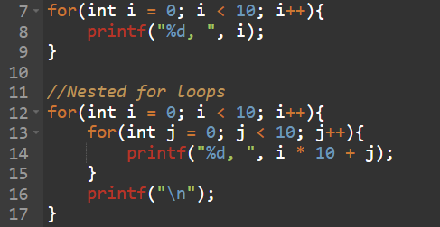
For Loops
Initialization
condition
false
true
execution
increment
Basic syntax of for loops includes Initialization, Condition, and Increment.
A for loop initializer is scoped to the loop body
In this example, variable “i” is gone after the loop

Slide 8
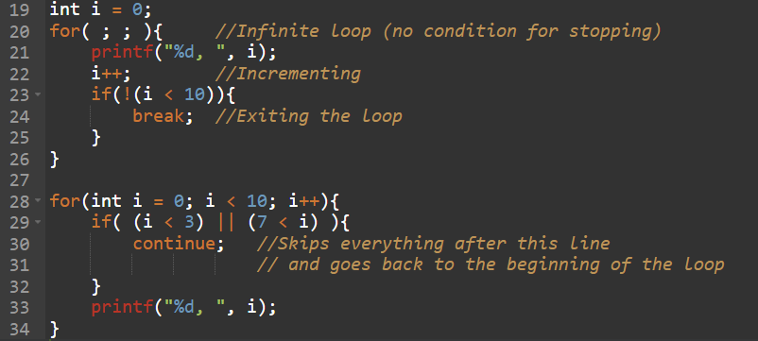
For Loops ( break, continue )
In C, we can also use “break” and “continue” to specify the condition for exiting the loop.
break: immediately exits the loop
continue:
Ignores the rest of the lines and goes back to the top of the loop

Slide 9
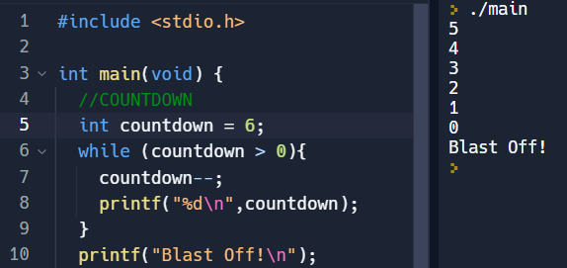
While Loops
Basic syntax of while loops still includes Initialization, Condition, and Increment.
Initialization is done prior to the loop, Condition is checked as the loop begins, and Increment is done inside the loop.
The variable “countdown” still exists after the while loop finishes

Slide 10
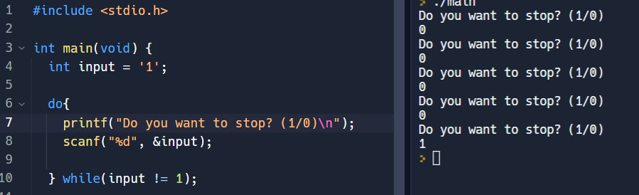
Do While Loops
Same setup as while loops with one exception, The Condition is checked at the end of the loop, after an Increment occurs.
The variable “input” also still exists after the do while loop finishes

Slide 11
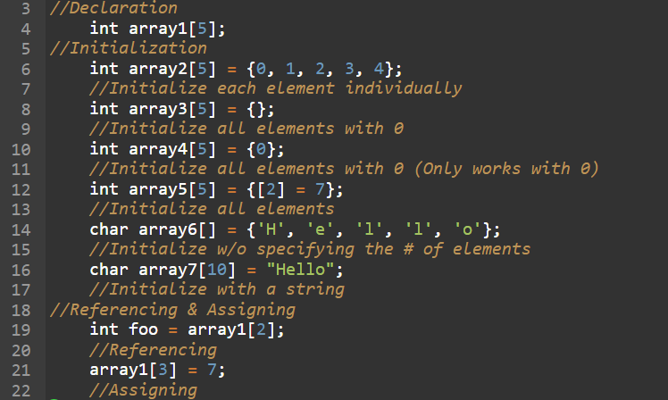
1D Arrays
The elements that you did not specify what to be initialized with will be initialized with 0
You can initialize an array without specifying the number of elements

Slide 12
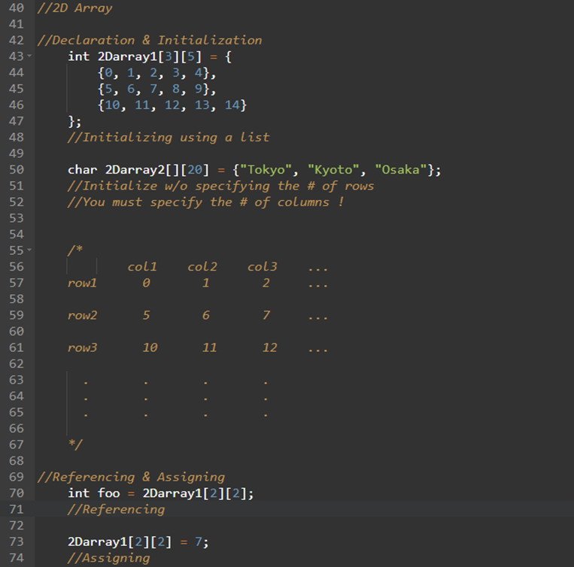
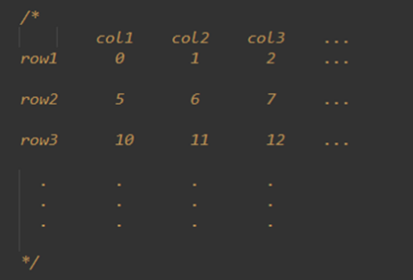
2D Array
2D Array is a matrix-like data structure that organizes its elements in rows and columns

Slide 13
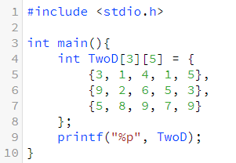
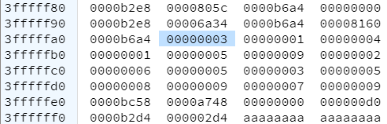
What a 2D Array looks like
In the memory, a 2D array is, in fact, just a 1D array
We are just treating a 1D array as a 2D array
n-D arrays are the same

Slide 14
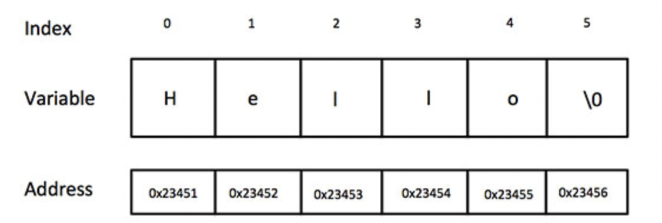
Strings
Character array terminated by a NULL character
Initializing a string in C language:
char greeting[6] = {'H', 'e', 'l', 'l', 'o', '\0'};
char greeting[] = "Hello";

Slide 15
String Functions - 1
strcpy(s1, s2);
Copies string s2 into string s1.
strcat(s1, s2);
Concatenates string s2 onto the end of string s1.
strlen(s1);
Returns the length of string s1.
strcmp(s1, s2);
Returns 0 if s1 and s2 are the same; less than 0 if s1<s2; greater than 0 if s1>s2.
Case sensitive, meaning ‘A’ and ‘a’ are treated as different letters.

Slide 16
String Functions - 2
strstr(const char *s1, const char *s2);
Returns a pointer to the first occurrence of string s2 in string s1.
strchr(const char *s1, const char c);
Returns a pointer to the first occurrence of the character c in the string str
Or NULL if the string or character is not found.

Slide 17
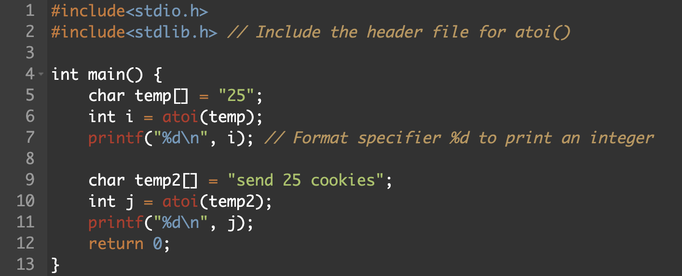
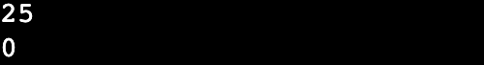
String Functions - 3
a to i()
int atoi(s1);
Converting a string to integer
float atof(s1);
Converting a string to float
ASCII
Integer

Slide 18
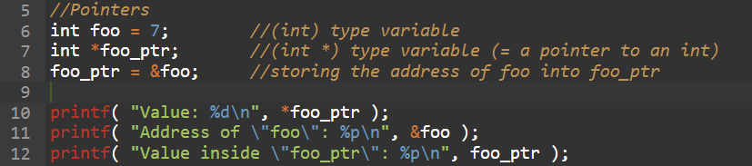
Pointer
Pointer is a variable that holds the memory address of another variable.
You can navigate through the memory using Pointer Arithmetic operations
Referencing (*) operator gets the actual content at an address
Address-of (&) operator gets the address of a variable
Output
0x3FFFFFC0
foo
0x3FFFFFD0
7
0x3FFFFFE0
0x3FFFFFF0
foo_ptr
0x40000000
0x3FFFFFDC

Slide 19
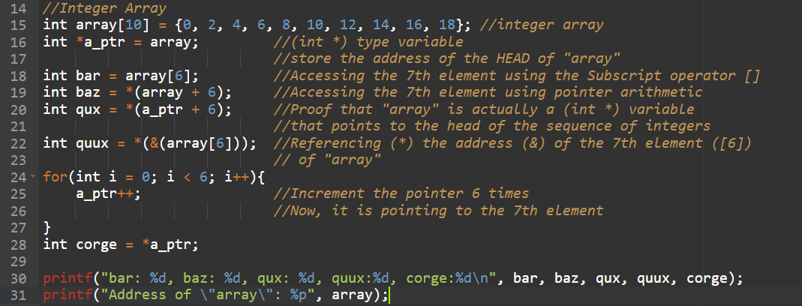
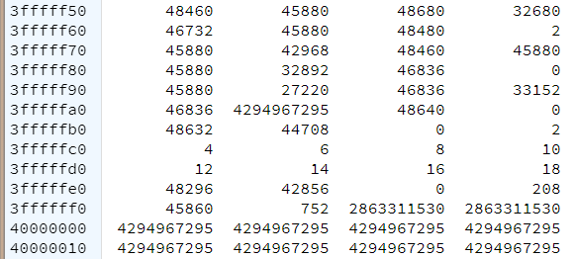
Pointer & Array
The name of an array is actually a pointer variable that points to the head of the array
You can use pointer arithmetic to iterate through the elements of the array
You can also use subscript operator ( [] ) to access each element
Output

Slide 20
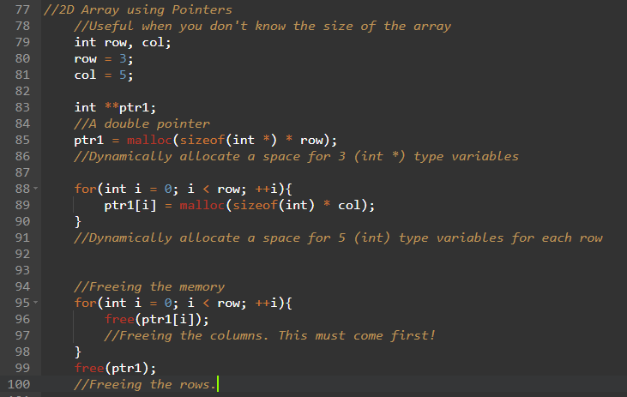
2D Array using Pointers
When you don’t know the size of the array, you can dynamically allocate memory location using pointers.
If you dynamically allocate memory, you always need to free them before the program ends

Slide 21
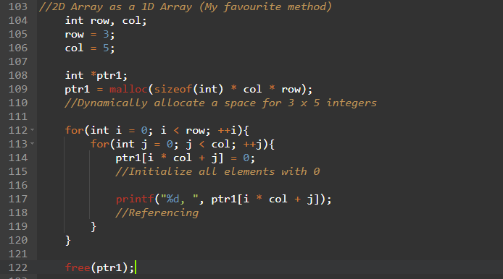
2D Array as a 1D Array
You can also use a 2D array using only one pointer.
This reflects the actual memory usage more accurately (I think)

Slide 22
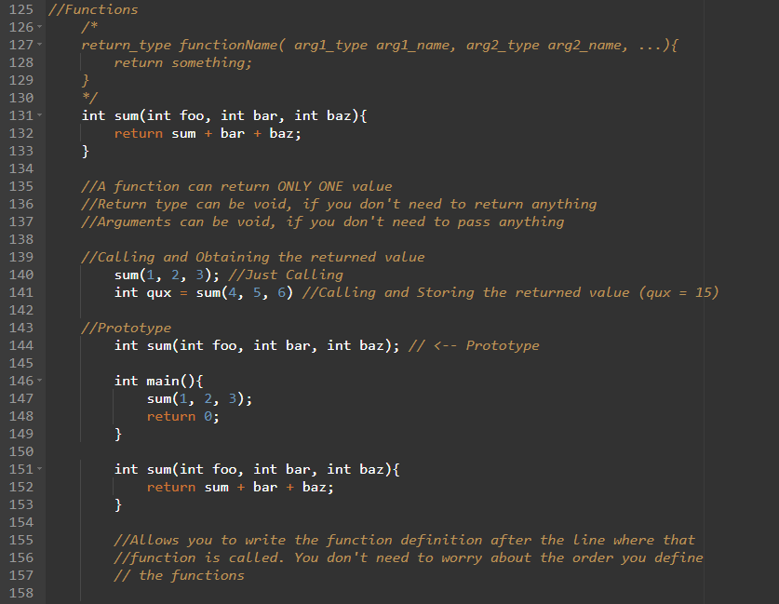
Functions
x
f(x)
y
A function performs a specific task/computation to multiple inputs (arguments) and returns a single output (return value)
You can also use a function prototype to declare the name, return type, and argument types to organize your code
You can use void for the inputs and the output, if you do not need to pass or return anything

Slide 23
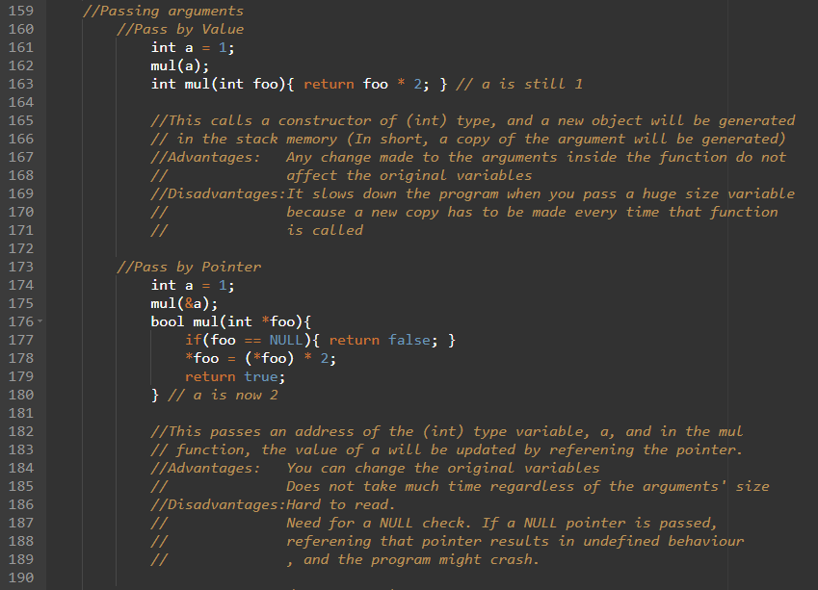
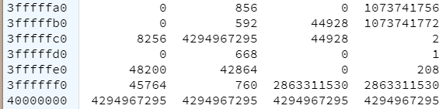
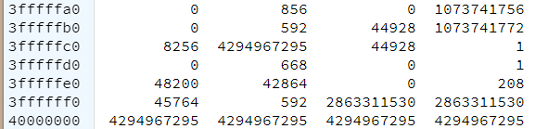
Passing Arguments (Pass by Value)
foo (int)
a

Slide 24
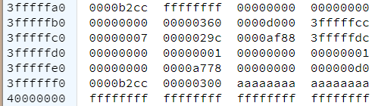
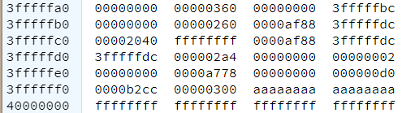
Passing Arguments (Pass by Pointer)
foo (int *)
a

Slide 25
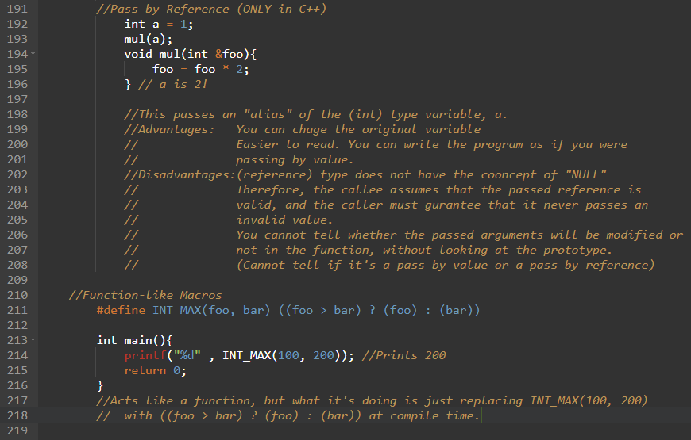
Passing Arguments (Pass by Reference)
0x3FFFFFC0
foo
a
0x3FFFFFD0
2
1
mul
0x3FFFFFE0
0x3FFFFFF0
0x40000000

Slide 26
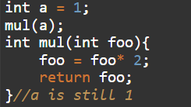
Passing Arguments (Summary)
 | Pros | Cons | Code
Pass by Value | Does not affect the original var | Takes time
Pass by Pointer | Can affect the original var Does not take time | Hard to read Need to NULL check
Pass by Reference | Can affect the original var No need for a NULL check Easier to read | Not allowed to pass an invalid value Cannot tell if the passed value will be changed

Slide 27
Function-like Macros
You can define a macro that resembles a function call
At compile time, the macro used in the code are replaced by the defined code (In this example, comparing “foo” and ”bar” and returning the bigger one)

Slide 28
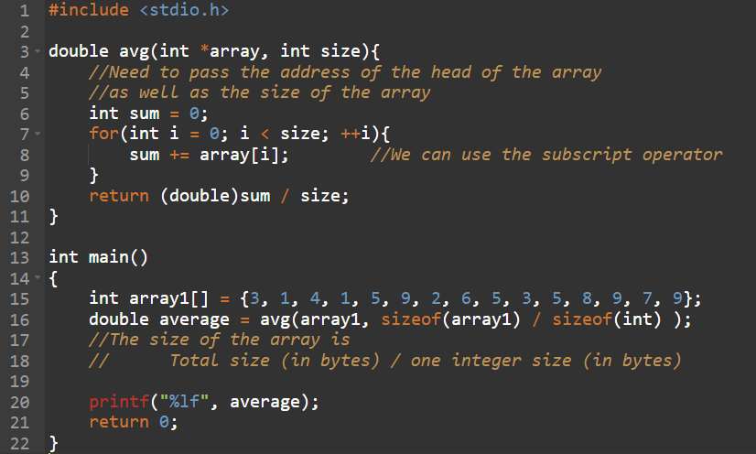
Passing Arrays to Functions (1D)
To navigate through all the elements of the array, you need the head address and the size
Safe way to obtain the size of an array is to use the sizeof operator

Slide 29
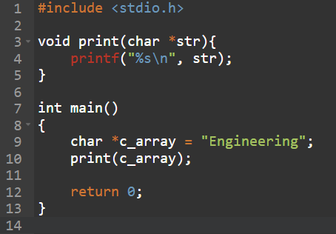
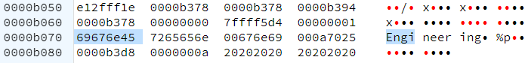
Passing Arrays to Functions (char 1D)
In the case of a char array, we do not need to pass the size, since char array always end with ‘\0’
Char is 1 byte
1 byte is 8 bits, meaning 1 byte can express 2^8 (=256), which is more than enough for ASCII code

Slide 30
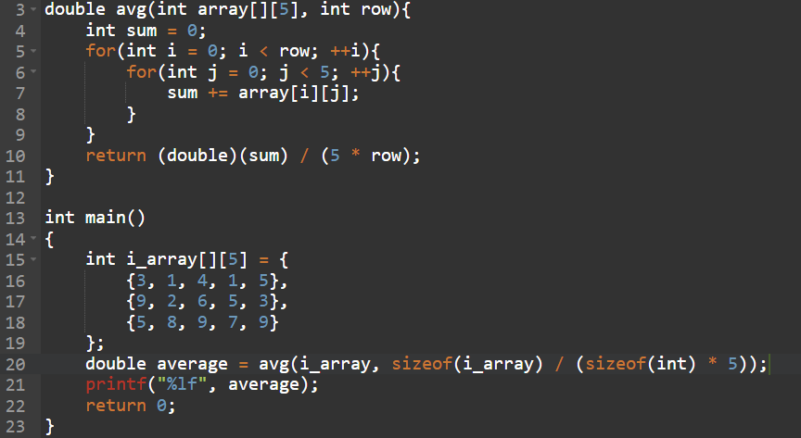
Passing Arrays to Functions (2D) - 1
In this syntax, the number of column is fixed, so we only need to pass the head address and the number of row
array is (int (*)[5]) type

Slide 31
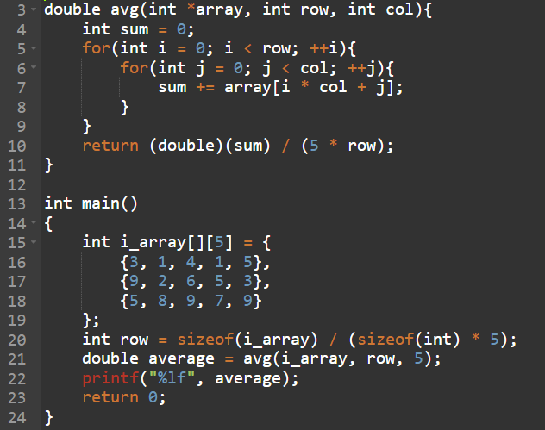
Passing Arrays to Functions (2D) - 2
In this syntax, we pass the head address, the number of columns and the number of row
The head address is a single pointer to (int) type
i_array is (int (*)[5]) type and needs to be typecast to (int *)
You can choose the number of rows and the number of columns freely

Slide 32
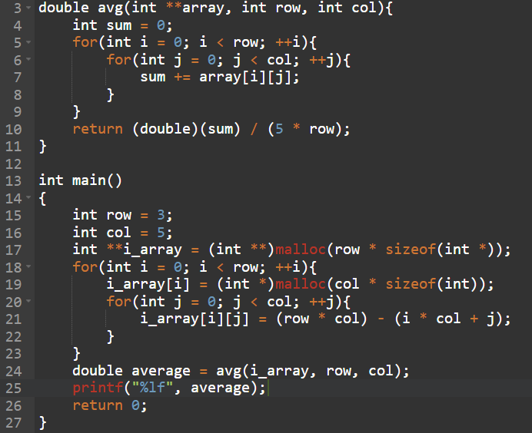
Passing Arrays to Functions (2D) - 3
You can pass a 2D array using a double pointer.
You can choose the number of rows and the number of columns freely
This method allows you to use the 2D array in a natural way inside the callee function

Slide 33
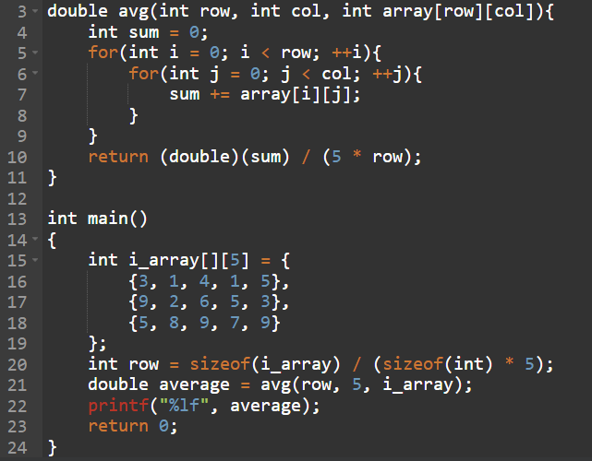
Passing Arrays to Functions (2D) - 4
This method only works for C99
The array name has to be the third argument

Slide 34
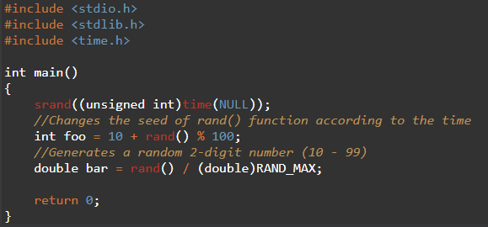
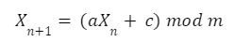
Random Numbers
Include the library “stdlib.h”
To get random number of a given range use “+” and “%”
rand() calculates X(n+1) based on X(n) using the LCG equation
Need to change X0 (seed) to get different random numbers every time
LCG equation

Slide 35

Challenge 1: Longest Palindromic String
Write a function that returns the longest palindromic string given a string
Palindromic: a sentence or a word that reads the same forward and backward.
Example:
Was it a cat I saw?
Function Prototype:
char * longestPalindrome(char * s);

Slide 36
Solution 1 (Simple)
Check for all the possible combinations
For a string of n letters, the number of iteration is n(n + 1)/2
Example)
banana → (banana), (banan, anana), (bana, anan, nana), (ban, ana, nan, ana), …

Slide 37
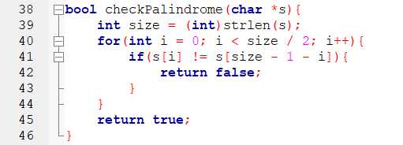
checkPalindrome(char *s)
Compare the nth element with the length - nth element

Slide 38
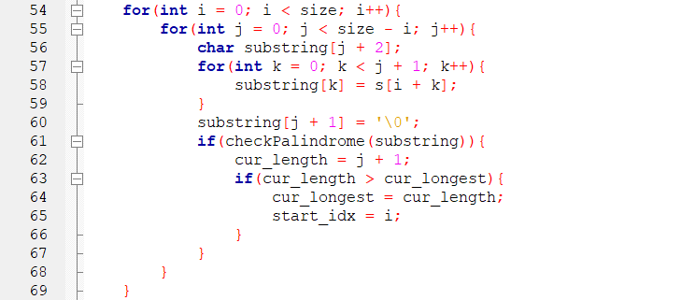
longestPalindrome(char *s)
Making a copy substring
Update only if the string is a palindrome and longer

Slide 39
Solution 2 (Faster)
Starting from a point, you expand outwards
For a string of n letters, the worst case iteration is n^2 / 4 + n(n-2)/4, the best case iteration is 0
b | a | n | a | n | a | \0

Slide 40
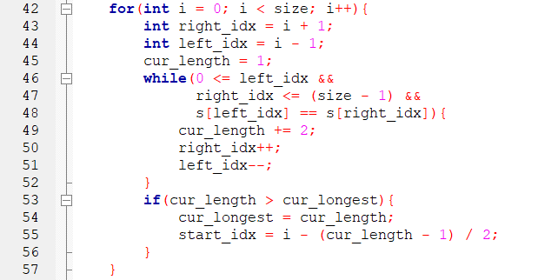
longestPalindrome (starting from a char)
i-2
i-1
i
i+1
i+2
If not out of bounds
& left end = right end
Expand as much as you can
If the expanded str is longer, update

Slide 41
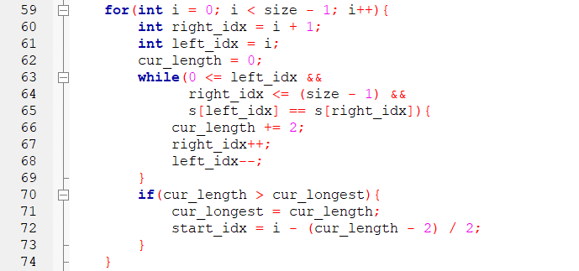
longestPalindrome (starting between chars)
i-1
i
i+1
i+2
If not out of bounds
& left end = right end
Expand as much as you can
If the expanded str is longer, update

Slide 42
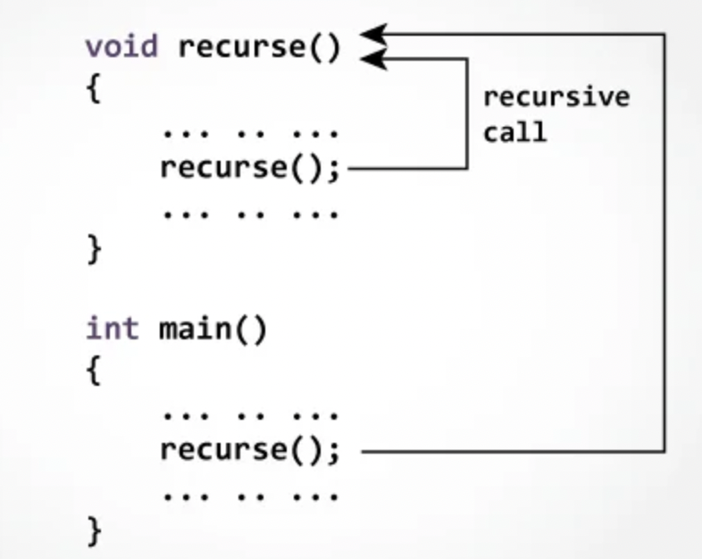
Recursion
The idea of approaching recursion to code in C
Considering the edge case(s)
Perform one step of the action
Assuming the result to the rest of the action is given by a magic person
Combine everything together

Slide 43
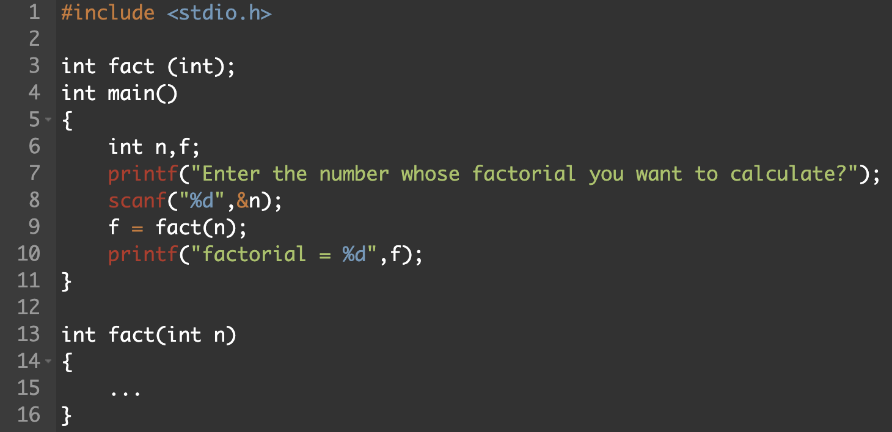
Recursion Example: finding factorial
The idea of approaching recursion to code in C
Considering the edge case(s)
Perform one step of the action
Assuming the result to the rest of the action is given by a magic person
Combine everything together
Your code goes here

Slide 44
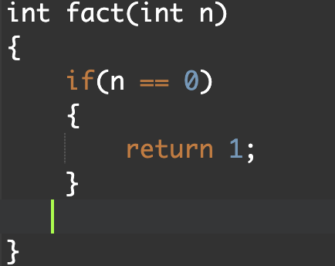
Considering the edge case(s)
If the user inputs 0?
We will simply get 1 for factorial of 0!

Slide 45
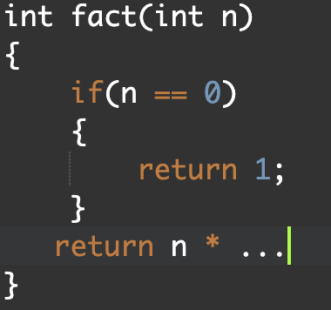
2. Perform one step of the action
As we know:
factorial of n
= n * (n-1) * (n-2) * … * 2 * 1
We are only coding one step of the entire multiplication

Slide 46
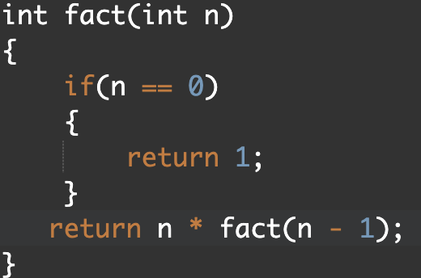
Assuming the result to the rest of the action is given by a magic person
As we know:
factorial of n
= n * (n-1) * (n-2) * … * 2 * 1
The rest of the multiplication is the factorial n-1
We assume that a magic person kindly provide us the answer

Slide 47
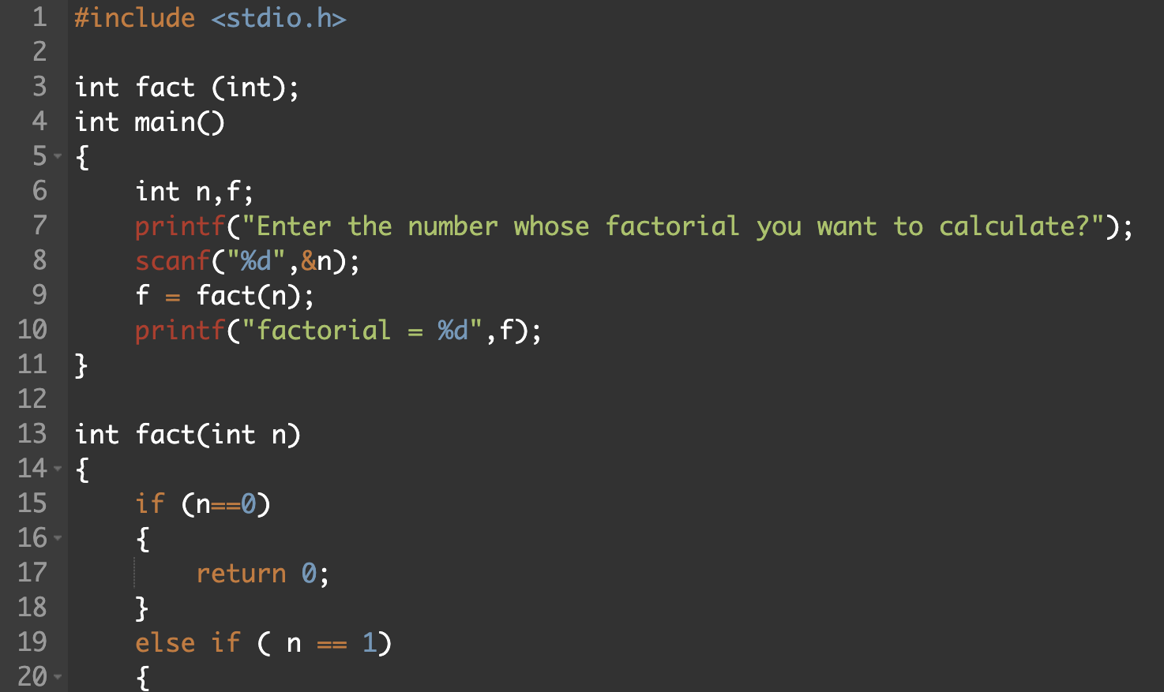
Recursion Example: finding factorial
The idea of approaching recursion to code in C
Considering the edge case(s)
Preform one step of the action
Assuming the result to the rest of the action is given by a magic person
Combine everything together

Slide 48
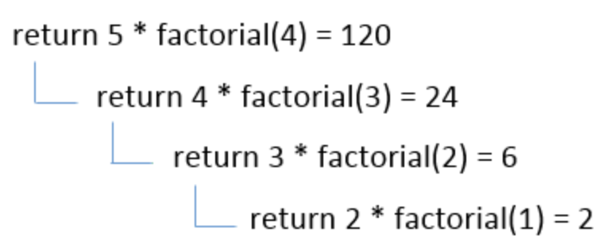
Understanding how recursion functions

Slide 49

Challenge 2: Permutation
Permutation is a number made by arranging numbers so that each number only appears once.
Example) permutations of {1, 2, 3}
(123), (132), (213), (231), (312), (321)
Find the kth permutation when listing all the n! permutations in ascending order.
Function Prototype:
char * getPermutation(int n, int k)

Slide 50
Solution
1234
1243
1324
1342
1423
1432
2134
Group 1 - 1
Group 2 - 1
Group 3 - 1
5th permutation?
Group 3 - 2
5 / 3! = 0 … 5 = Group 1-1
5 / 2! = 2 … 1 = Group 2-3
1 / 1! = 1 … 0 = Group 3-1
Group 2 - 2
Group 3 - 1
Group 3 - 2
Group 2 - 3
Group 3 - 1
First unused from [1, 2, 3, 4]
Third unused from [2, 3, 4]
First unused from [2, 3]
The last one [4]
The 5th permutation is:
1423
Group 3 - 2
Group 1 - 2
Group 2 - 1
Group 3 - 1

Slide 51
Example: n = 5, k = 89 (1 ≦k≦5!)
Step 1: What is the most significant digit? In which group does it belong to?
Question 1: How many different permutations are there
5! = 120
Question 2: How many groups are there when you classify all the permutations based on their most significant digit? How many permutations in each group?
5 groups, 4! permutations in each group
Question 3: In which group does 89th permutation belong to
89 / 4! = 3 → 4th group

Slide 52
Example: n = 5, k = 89 (1 ≦k≦5!)
Question 4: What is the position of 89th permutation in the group 4?
89 % 4! = 17 → 17th permutation
The 89th permutation belongs to the group 4, and is the 17th permutation in the group 4
Group 1 - 3
} 24 permutations
41235
.
.
.
45321
Group 1 - 4
89 th overall
17th in group 1-4
Group 1 - 5

Slide 53
Example: n = 5, k = 89 (1 ≦k≦5!)
Likewise,
in group 1-4, there are 4 subgroups each containing 3! (= 6) permutations
17 / 6 = 2 (89th permutation belongs to the group 2-3)
17 % 6 = 5 (5th permutation in the group 2-3)
Group 1 - 3
41235
.
.
.
.
.
.
45321
Group 1 - 4
Group 2 - 1
Group 2 - 2
89th overall
17th in group 1 - 4
5th in group 2 - 3
Group 2 - 3
Group 2 - 4
Group 1 - 5

Slide 54
Example: n = 5, k = 89 (1 ≦k≦5!)
Likewise,
in group 2-3, there are 3 subgroups each containing 2! (= 2) permutations
5 / 2 = 2 (89th permutation belongs to the group 3-3)
5 % 2 = 1 (1st permutation in the group 3-3)
Group 1 - 4
Group 2 - 2
Group 3 - 3
43125
.
.
.
.
.
.
43521
Group 2 - 3
Group 3 - 1
Group 3 - 2
89th overall
17th in group 1 - 4
5th in group 2 - 3
1st in group 3 - 3
Group 3 - 3
Group 2 - 4
Group 3 - 1

Slide 55
Example: n = 5, k = 89 (1 ≦k≦5!)
Likewise,
in group 3-3, there are 2 subgroups each containing 1! (= 1) permutations
1 / 1 = 1 (89th permutation belongs to the group 4-1 (remainder = 0))
1 % 1 = 0 (1st and only permutation in the group 4-1)
Group 1 - 4
Group 2 - 3
Group 3 - 2
Group 4 - 2
Group 3 - 3
Group 4 - 1
89th overall
17th in group 1 - 4
5th in group 2 - 3
1st in group 3 - 3
1st in group 4 - 1
43512
43521
Group 4 - 2

Slide 56
Example: n = 5, k = 89 (1 ≦k≦5!)
89th permutation belongs to
Group 1 - 4
Group 2 - 3
Group 3 - 3
Group 4 - 1
1
0
2
3
0
4
0
5
0
43512

Slide 57
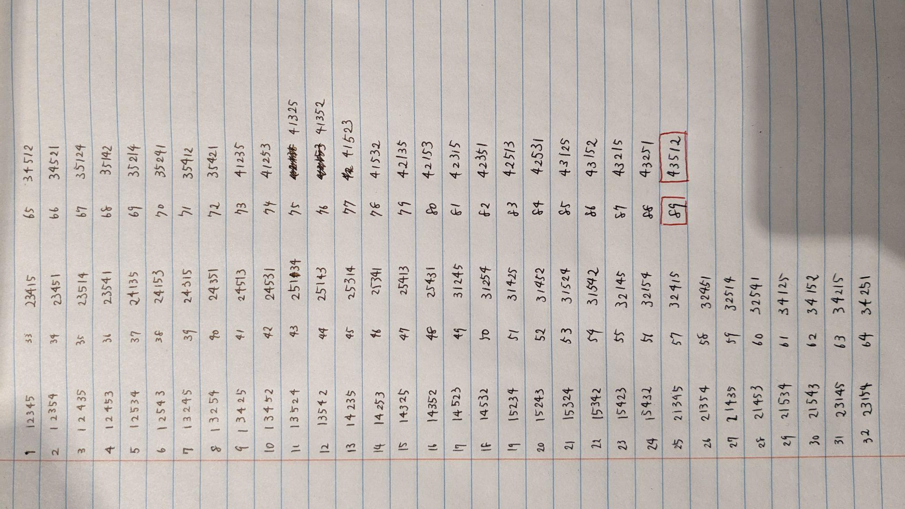
Still skeptical?

Slide 58
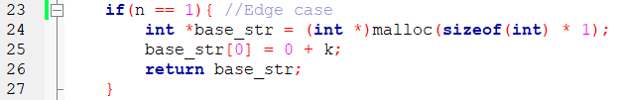
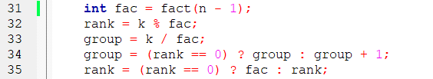
int * recursion(int n, int k)
Always 0 (Why ?)
n: the number of “numbers” left unselected
k: position starting from the smallest number in the current group
When the permutation you are looking for is the last member of a group
rank: position in the next smaller group
group: the current group

Slide 59
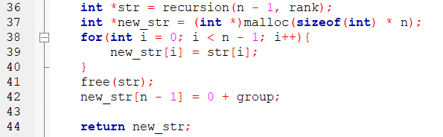
int * recursion(int n, int k)
recursion function
Calls itself after selecting one number (group) and updating the position in the next group (rank)
Stores the returned int array in a pointer str
Copies the returned int array in a bigger int array new_str
Adds one value (current group) at the end of new_str

Slide 60
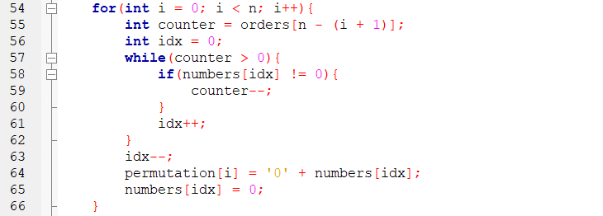
char * getPermutation(int n, int k)
Calling the recursion function
orders tells you in which group the nth least significant digit belongs to
Increment idx until you reach the counter-th unused number
Store the corresponding number
Mark as used
numbers is an int array that contains all the number from 1 to n (size n)

Slide 61

Scan for Sudoku Skeleton

Slide 62



Sudoku
Each row, column, and 3x3 subgrids must contain all the numbers from 1 to 9 without any repetition
Based on the numbers that are already there, you fill in the whole grid
New York Times

Slide 63
Flow
Empty Grid
Get User Input
Check if the Grid is Full
Fill the Grid
Check Legality
Remove Elements
Place the Move
Generation Stage
Play Stage
Finish Stage

Slide 64


Header and Implementation
Header
(.h)
Implementation
(.c)
Header files usually use this format (↑) to prevent multiple inclusion
#ifndef means “Define only if it has not defined yet”
Hides implementation but still shows the functionality
Can be included in multiple files

Slide 65
int generatedGrid[9][9];
main
.c
0
1
2
3
4
5
6
7
8
A 2D array
First, we will fill this 2D array with random numbers following the sudoku rules (→ linearFill)
Then, we remove some of the numbers to create a puzzle (→ removeKDigits)
We will print this 2D array on the console (→ printSudokuGrid)
Then, we get the user input, check if the user input is valid, and update the 2D array (→ playing)
0
1
2
3
4
5
6
7
8

Slide 66

void linearFill(int grid[9][9])
sudoku
Generator
.c
We will use a 2D array int availableNum[81][9] to keep track of which number works and which number does not
Each row represents a cell in the grid
Starting from top left, for each cell, we select a random number and see if it is valid to place that number in that cell
If it is, update int grid[9][9], mark that number as used in availableNum, and go to the next cell
If it is NOT, try another number until you find a number that it works
If none of the number works, go back to the previous cell, select other available number, and restart with that number

Slide 67
int availableNum[81][9]
sudoku
Generator
.c
9
0
2
3
4
5
6
7
8
9
random
10
1
2
0
0
5
6
7
8
9
Row 1
7
6
9
3
2
11
1
0
0
4
5
6
7
8
0
12
1
2
0
4
0
6
7
8
0
13
1
2
0
4
0
0
0
8
0
0
1
2
3
4
5
6
7
8
14
1
2
0
4
0
6
0
0
0
0
1
4
2
9
6
3
7
8
5
15
0
2
0
4
0
6
0
0
0
1
3
9
5
7
8
1
2
6
4
16
0
0
0
4
0
6
0
0
0
2
6
8
7
2
4
5
3
1
9
17
0
0
0
4
0
0
0
0
0
3
18
0
2
0
4
5
6
7
8
9
4
19
1
2
3
0
5
0
7
8
0
Row 2
5
20
1
0
3
4
0
0
7
0
9
21
1
2
3
4
5
0
0
0
0
6
7
8

Slide 68

Code Board https://codeboard.io/signup
Look for this comment and fill that part with your code!

Slide 69

Activity 1: printing a board
sudoku
Generator
.c
https://codeboard.io/projects/390517
Expected Output:
The numbers on the board does not matter
Your goal is to make the board printed on the console
After successfully finishing this activity, you can modify your code to make the board even cooler than ours!!! (adding colors, more bars etc)
Don’t Forget to Submit ;-)

Slide 70


Activity 1: checking the legality of moves
sudoku
Generator
.c
https://codeboard.io/projects/390533
Your goal is, given a user input (this part is already done), to check if that input move is legal
If the move is legal, the board will be updated(this part is also done)
If the move is not legal, it asks for another user input (this part is also done)
This is not necessary, but you can also take a look at main.c to see how getting user input works
Don’t Forget to Submit ;-)
Valid Moves
Invalid Moves

Slide 71


Activity 2: out of number & replenish
sudoku
Generator
.c
https://codeboard.io/projects/390530
Initial Output:
Expected Output:
The numbers on the board does not matter
Your goal is to detect the rows that is out of available numbers and replenish them with numbers 1 - 9
These functions are for availableNum[81][9]
Don’t Forget to Submit ;-)

Slide 72


Activity 3: filling the board
sudoku
Generator
.c
https://codeboard.io/projects/390529
Your goal is, given an empty 9x9 2D array, to generate a complete sudoku board that does not violate the rules
You should use a rand() function in a way that every time you run this function, you get a different sudoku board
This function needs to call the functions you implemented in activity 2 & activity 3
1st Run
2nd Run
Don’t Forget to Submit ;-)

Slide 73


Activity 4: removing some numbers
sudoku
Generator
.c
https://codeboard.io/projects/390535
Your goal is, given a complete sudoku board, to remove some numbers to make it a puzzle
You should use a rand() function in a way that every time you run this function, you remove different cells
This activity is independent from the last 4 activities, but we will combine all of them later
We can adjust the number of cells we remove to change the difficulty of the puzzle
Filled
Don’t Forget to Submit ;-)
Removed

Slide 74

Activity 5: let the user play with the game
play
Mode
.c
https://codeboard.io/projects/390506
Your goal is to complete the fully functional sudoku game
playing function should ask for the user’s input, check its legality, and decide whether that move should be played or not
You should also check for unexpected user inputs to prevent the program from crashing
After finishing this part, you can work on further to improve the user interface!
Don’t Forget to Submit ;-)

Slide 75

Our Solution
https://replit.com/@ShuntaroWakamat/Sudoku
Debugging & Testing: Simon, Nick
Commenting & Organizing Code: Ryan
Adding Color: Iris
Activities: Me

Slide 76

Give It a Try! “Power of Three”
Given an integer n, return true if it is a power of three. Otherwise, return false.
An integer n is a power of three, if there exists an integer x such that n == 3x.
Example 1:
Input: n = 27
Output: true
Explanation: 27 = 33
Example 2:
Input: n = 0
Output: false
Explanation: There is no x where 3x = 0.

Slide 77

Sample solution of Power of Three

Slide 78
ECE Summer Workshop Software
APS105 Review & ECE244 Preparation
Day 2

Slide 79
Today we will be covering:
Dynamic Memory Allocation
Struct
Linked Lists
Sorting Linked Lists

Slide 80


String I/O - 1
gets(s1);
puts(s1);
printf(), scanf() for strings.

Slide 81
String I/O - 2
Difference between gets() and scanf()
In scanf() function white-space is not considered as input character and also it stops reading input from external source if any white-space is encountered in between
On other hand gets() function is used to receive input from the keyboard till it encounters a newline or EOF. The whitespace is considered as a part of the input.

Slide 82
String I/O - 3
Difference between gets() and scanf()
Scanf() function takes the format string and list of addresses of variables. e.g. scanf(“%d”, &number);
It can also read multiple values of different data types.
On other hand get() function takes the name of the variable to store the received value. e.g. gets(name);
get() function will only get character string data.

Slide 83

Moving on…

Slide 84
Dynamic Memory Allocation
Why use Dynamic Memory Allocation in C?
An array is a collection of a fixed number of values.
Declaring the size of the array which is unknown might cause insufficiency.
To solve this issue, you can allocate memory manually during run-time
Notes:
So Why is Dynamic Memory Allocation necessary? As we know, An array is a collection of a fixed number of values, which means once the size of an array is declared, you cannot change it. Sometimes the size of the array you declared may be insufficient as the array size is unknown originally and you are waiting for users input during runtime . To solve this issue, you can allocate memory manually during run-time. That is known as dynamic memory allocation in C programming.

Slide 85
Dynamic Memory Allocation
All functions are defined in the <stdlib.h> header file
malloc()
ptr = (castType*) malloc(sizeof(castType));
Memory is uninitialized
calloc()
Memory is initialized with all bits to zero
free()
Frees used memory to prevent memory leaks
Notes:
Dynamically allocated memory created with either calloc() or malloc() doesn't get freed on their own. You must explicitly use free() to release the space.

Slide 86




Slide 87
Variable Length Arrays + Scanf(%ms)
Whereas, malloc gives you more manual control, you can let the computer handle memory allocation:
You can let the computer handle assigning memory for the array the same way as when you assign arrays a length, but use a variable instead (Variable Length Arrays)
“array[n]”
Need to be careful of variable scope
You can also take in strings dynamically using %ms (malloc string), so that you don’t have to pre-assign memory for a string
“scanf(%ms, char* variable)”

Slide 88
Let’s Build It: Pokemon Activity
Create a dynamically changing array database of length n, received from the user which stores the names (strings) of pokemon, that are also received from the user.
As a template:
Get the user to enter in the number of pokemon they want to add
Get the user to type in the names of ‘n’ pokemon
Build the dynamic 2D array database of pokemon names

Slide 89

Struct
You can create a structure by using the struct keyword and declare each of its members inside curly braces:

Slide 90


Struct
Create a struct variable with the name “s1”
Defining our own "syntactic sugar" using the typedef keyword.
typedef
myStructure;

Slide 91

Struct
To access members of a structure, use the dot syntax (.):

Slide 92

Struct
You can also assign values to members of a structure variable at declaration time, in a single line.

Slide 93



Linked Lists
Collection of nodes/structs linked together by pointers
Adjacent in Memory?
No, the pointer allows the node to be anywhere

Slide 94

Linked Lists: Nodes
Code For Activity:
https://codeboard.io/projects/390588

Slide 95

Linked List: Insert

Slide 96

Linked Lists: Print

Slide 97

Linked Lists: Find

Slide 98

Linked Lists: Delete

Slide 99
Mini Activity: Using LinkedList
Play around with the four operators for the LinkedList
Example Challenges:
Insert Nodes from 0-99 in random order and print them
Delete odd numbered nodes
Challenge: build a doubly-linked list

Slide 100

Activity: Pokemon Database
Build a LinkedList database that keeps track of Pokemon
Store at least the name and pokedex number (but you can add more!)
You can either add more data to the Node struct and rename it or replace int key with a new struct called Pokemon
Build a console user interface to insert, print, find, and delete pokemon from the database
Pseudo-code given in main.c

Slide 101

Linked Lists: Sorting
General Idea: Divide and Conquer
Recursively make splits
Merge them back together in
sorted order
*Special considerations for linked lists:
Swapping Numbers -> Swapping Nodes
Middle of an Array -> Middle of List

Slide 102
ECE Summer Workshop
Software
APS105 Review & ECE244 Preparation
Day 3

Slide 103
Sorting Algorithms
Iterative
Recursive
Bubble Sort
Insertion Sort
Merge Sort
Quick Sort
Notes:
Introduce you to algorithms; 297
More often than not, you won’t be coming up with an algorithms scratch
You’ll typically be adapting ones that exist
Research: What exists, what works well for what cases?
Know how to break down an algorithm so that you understand how it works and how to use/adapt it for your own use-case

Slide 104
What makes a sorting algorithm fast?
Comparisons: How many comparisons, before we know we’re done?
Data Movement: How often does it have to shift data around?
Setup Time: How quickly can it make those comparisons?
Randomness: The data we’re given, might already be partially sorted, or sorted already in a unique way than what we desire
ie. sorted from highest to lowest, when we desire lowest to highest
Notes:
There is some randomness involved with the data we’re given, as it might already be partially sorted, or sorted in a different way than what we want (ie. sorted from highest to lowest number, when we want lowest to highest)

Slide 105

Time Complexity
Big-O Complexities:
O(1)
O(logn)
O(n)
O(nlogn)
O(n^k)
O(k^n)
O(n!)
Notes:
n = size of a set
O() = how many operations you do for a given set of size n
O(1) is instant, one operation and you’re done
A measure of efficiency, when algorithms are given the worst possible starting conditions, and it’s important to note that it is an approximation
You can have two algorithms that are both O(logn), and one can be faster than another given the considerations discussed in the last slide
But when comparing two different tiers, say O(n^2) vs. O(n), you can typically say that the O(n) algorithm is faster

Slide 106

Bubble Sort
Time Complexity
Best: O(n^2)
Worse: O(n^2)
Sort array through shifting biggest numbers to the end
Notes:
Outline (iterative)
Give context:
Working with an array of integers
We want to sort it from smallest to biggest numbers
Teach:
Explain the general idea: Move biggest stuff to the end
Give the time complexity (not great)
Give why: It’s still ok for very small data sets; a good starting point for us to work with
Have them code it:
Use activity sheet to help them break it down into what they need
Get the size of the array
Re-Traverse array N-1 times
Traverse the array and shift bigger numbers up
Done
Simple 2 for loop + check for bigger number = make a swap
(GIVING THEM THE SWAP FUNCTION JUST FOR SIMPLICITY)

Slide 107

Insertion Sort
Time Complexity
Best: O(n)
Worse: O(n^2)
Sort array by shifting numbers backwards into their correct spots
Notes:
Outline (iterative)
Teach:
Explain the general idea: Starting from left to right, move numbers backwards and insert them into where they should be
Give the time complexity (a big improvement upon bubble)
Why: Bubble will still traverse the array multiple times and not make any swaps if the array is sorted
Insertion will stop earlier once it knows the number is in the right spot, saving some time depending on your luck
Give why: Good improvement for an iterative solution
Have them code it:
Use activity sheet to help them break it down
We will iterate through all numbers in our set from the second position to the end
We start with the 2nd index since the starting with the first is useless (nothing to compare it to and you can’t move it backwards anymore)
We then have to take the number and move it backwards until either we hit a number that is smaller than it, or we reach the start of the array
For loop or while loop for this?
For loop + While loop + a slightly more complex stop condition while making swaps

Slide 108
Merge Sort
Time Complexity
Best: O(nlogn)
Worse: O(nlogn)
‘Divide and conquer’
Notes:
Outline (recursive)
Give context:
Now switching to a recursive algorithm
Technically could do it iteratively but both merge sort and quick sort require a lot of complex code (Doing it recursively is meant to make it easier for us)
Important to note the interchangeability between the two
Teach:
Split the array into segments until you get pairs of 1 (a pair of 1 is already sorted)
Then when recombining (the recursive part of this), sort the numbers
Give the time complexity (much better than before, + results are consistent)
Have them code it:
Use activity sheet to help them break it down into what they need
Give our algorithm our array, and then the left and right indexes
Always split array into the middle, stop when left == right
By this point, we have all of our splits; now we combine and sort as we do so
Make a copy of the split arrays (2 temporary arrays) to be used for comparisons
Combine the two arrays into the main one (can use an example)
Compare between each
Once we reach the end of one, we just add the last bits of the other
2 for loops for temp, while loop for main sorting + 2 while loops for cleanup

Slide 109

Quick Sort
Time Complexity
Best: O(nlogn)
Worse: O(n^2)
‘Divide and conquer’ with more risk
Notes:
Outline (recursive)
Give context:
The one you always hear about
Teach:
The same idea as merge sort with splitting the array up but instead we focus on the index that we chosen and organize everything else around that point
Until we know that it’s in the right spot
Not as consistent as merge sort, and has the possibility to be slower, BUT
This process typically lets us know the correct locations of all indexes faster than merge sort does
It will make the same number of comparisons, but it will make those comparisons faster than merge sort does
Have them code it:
Use activity sheet to help them break it down into what they need
Need to select a partition (we are going to choose the last one initially)
We will sort that index into its right place
Get value of last number in array
Shift all numbers smaller than it before ‘i’
Shift all numbers bigger than it after ‘i’
i will be incremented once after every swap
Swap the last number in the array with i and it will be therefore be in the right spot
We then call quicksort on the arrays around that partition and select a new partition again
Repeat until done

Slide 110

Quick Sort - Median of 3 Improvement
Time Complexity
Best: O(nlogn)
Worse: O(n^2)
Notes:
No longer selecting the last number
We will organize three numbers and choose the center as our pivot
Requires a more complicated sorting algorithm to get the pivot in the right spot
We do this to reduce the chances of getting that O(n^2) worst case scenario
Imagine choosing the highest index in the array every time when it is already mostly sorted with a few numbers out of place near the start
Choosing the center in that case would make things go faster, even if it adds a little bit more prep time to do so

Slide 111
Can this work with Linked Lists?
Adjustments we would have to make:
How do we traverse through nodes?
How do we compare nodes?
How do we swap nodes?
Notes:
Rewrite the insert function of the previous day’s code to be ordered

Slide 112
ECE Summer Workshop
Software
APS105 Review & ECE244 Preparation
Day 4

Slide 113
Binary Tree
A binary tree is a tree structure, with a parent node having at most two children nodes.
It is represented using a pointer to the root node of the binary tree.
There is no restriction of how the nodes of a binary tree should be structured, except for at most 2 children nodes per parent node.

Slide 114

Binary Search Tree
A node-based binary tree, with the nodes arranged in an order
Value of the left child < value of the parent node
Value of the right child > value of the parent node
Root

Slide 115

Define a BST

Slide 116

Create a new node for a BST
Default constructor
Returns a pointer to the BSTNode

Slide 117
Insertion in BST
Returns the root of the new BST after being modified
Determine the order you want the BST to be based on!
In this case, “string” is the one being evaluated on to determine the order of the BST.
How to determine the order of the strings? How to actually insert all the nodes based on alphabetical order?
Start with the most basic case…

Slide 118

Insertion of new node
Since it is a BST structure, the root will never change when we are inserting the new node after the first node is selected as the root, so we will start from here.
The “node” here is the root of the BST to be inserted into.
Also important for the recursion process coming later.

Slide 119

Insertion of new node
Compare the strings using strcmp(), to determine the order.
Recursion until find the correct location to insert the node!

Slide 120

Avoid duplicate values
By definition, BST cannot have duplicate values for the order key.
Either use another key to determine the “secondary order”, or do not insert the value at all.
If you decide to use another key to determine the secondary order, make sure to account for it in your deletion algorithm as well.

Slide 121

Searching in BST
Use strcmp to compare the key and the root’s string, if no match, then based on the value, go into either the right or left subtree and do recursion.

Slide 122
Deletion in BST
Deletion is a bit complex in BST, just because after deletion, the BST has to still remain sorted.
You have to search for the matching BSTNode first, and then delete it following the rules of the BST. You don’t have to search for the things that sorts the list (in our case, the string), but you have to use the thing that sorts the list to arrange the BST after deletion.
Again, let’s use divide and conquer approach, starting from the most basic case…

Slide 123
Deletion in BST
Basic case 1: The matching node has no children. In this case, we have to delete and free the node, go back to the parent node and make it points to NULL.
Basic case 2: The matching node has only one children. In this case, we only have to make the parent node of the deleted node pointing to its only children, and delete and free the node.

Slide 124

Deletion in BST - Basic case

Slide 125

Deletion in BST - 2 children
So, what if there are 2 children for the BSTNode of the matching key?
Get the in order successor (in this case, the smallest key in this BST that is larger than the matching key), “replace” the deleted node with it.
We need a helper function that finds the in order successor, which is the left most node of the right subtree of the original BST.
In order successor

Slide 126

Deletion in BST: 2 children
It is like a chain reaction, you are replacing the deleted node with its inorder successor, but that will also cause the original inorder successor node to be “deleted”, so you have to go delete that node and update the root of the subtree.

Slide 127

Deletion in BST: recursion
Now we add the last part of the deletion: recursion, which if the string is larger than the root’s string value, we move to the right subtree of the BST, and vice versa.
You can find the sample completed solution in your materials.

Slide 128

Traversal in BST
In order traversal: left -> node -> right
Pre order traversal: node -> left -> right
Past order traversal: left -> right -> node
For BST, the in order traversal will get all the elements traversed in the ascending order (and hence the in order successor in the deletion part).

Slide 129
Activity on BST
Go to the following website for example LeetCode questions and complete them to test your understandings.
If you don’t have a LeetCode account, you can register one quickly.
If there are any questions, feel free to reach out to us!
https://leetcode.com/problems/search-in-a-binary-search-tree/
https://leetcode.com/problems/convert-sorted-array-to-binary-search-tree/
https://leetcode.com/problems/validate-binary-search-tree/
https://leetcode.com/problems/insert-into-a-binary-search-tree/

Slide 130
Header files, modularity and project organization
Makes no difference to the compiler, but makes a lot of difference to you and your co-workers!
Imagine working on a project that involves million lines of codes…
Split the codes into different functions, and put different functions into different files.
Potential benefits:
Division of work between you and your co-workers
Easier to debug and maintain the code
Easier for others to add more things to your code without causing conflicts or problems!
You will understand the importance of it in ECE297…

Slide 131

Header files
Each header file (.h) has its own matching source files (.c), where usually header files includes the function declaration, and the source file includes the function definition.
By including the header files, you are able to use the functions defined in its source files.
Example: One of the files in our ECE297 mapper project

Slide 132
Header Files
It is a good practice to write comment in the header files about what the function does, so without knowing what the actual code is in the source file, others will know how to use those functions.
Connection to Black Box Method and business collaboration…

Slide 133

Same header files being included multiple times
Causes compilation errors!
Equivalent to multiple declaration of the same functions
Solution: guard the header files!

Slide 134

Hash Table
Key, data and index.
Use a function to convert the key to the index in the hash table (usually a big array), which stores a pointer to a struct with all the data in there.
It gets much easier to use in C++, which you have access to:
Vector
Class and objects
Operator overloading

Slide 135

Hashing functions
Example hashing function:
Index by division: h(k) = k % m, which m is the size of the table
Key
Index

Slide 136
Collision resolution
Sometimes the hashing function will get the same index for two different keys, which will then cause collision
Commonly, there will be 2 resolution methods:
Chaining
Open addressing/linear probing

Slide 137

Chaining
Similar to linked list!
Link the conflict struct as linked list after the first one
Construct the struct with a pointer to the next struct, set to NULL by default (just like how we did in linked list).

Slide 138
Open addressing/linear probing
Change the original hashing function into a recursive one.
If the index is not available, keep doing recursion until an available slot is found.
Depends on the purpose of the hash table, it may increase the time complexity, of accessing the data stored.

Slide 139

Open addressing/linear probing

Slide 140
Q&A Session
Ask us anything!

Slide 141
ECE Summer Workshop
Software
ECE244 Preparation
Day 3

Slide 142
Today we will be covering:
Comparison of C and C++
I/O and Strings
Object Oriented Programming and Classes
Accessors and Mutators
Constructors and Destructors

Slide 143
Difference between C and C++
Although C is completely compatible in C++, the main idea is different. C is a procedural language and C++ is object oriented. Because of that, C++ can be used to build more complex applications in a better and more efficient way.
And now we are going to take a look at the things in C++ and compare it with how we originally do it in C.
Remember: you can always just write C in C++, but now you have a better tool so why bother…

Slide 144
Difference between C and C++
Procedural Language
Code executes top to bottom
Lower level language
Faster to compile
Better for hardware
Object Oriented Language
Code is organized into objects and namespaces
Higher level language
Takes longer to compile but it’s easier to code/read
Better for software
Important because:
As programs get bigger, upfront planning becomes especially important and the structure from objects help with this
Allows programmers to join projects faster (smoother onboarding)

Slide 145
Difference between C and C++ Cont’d
We’ll go through:
Syntax difference
Underlying functionality difference (where necessary)

Slide 146



User I/O Syntax
In C, you have to specify the type of input and output, and consider the spaces in input and output
In C++, you do not have to specify the type, and you do not need to take consideration of the spaces when user inputs
Both cin and cout are objects of the class iostream
Notes:
On a side note, scanf is faster than cin, but only because when doing cin, it has to synchronize with the underlying C library, which means, it has to call scanf as well along with cin. You can turn down the synchronization and that will make cin faster than scanf.

Slide 147
I/O Underlying Functionality
The library is called <iostream> because the input and output flow in and out of the program
The input flows from the cin stream into program
The output flows from the program into the cout stream

Slide 148


Strings Syntax
In C, a string is represented as an array of characters, with a pointer to the start of the array.
You use different independent string handling functions to do actions to strings like duplication and comparison.
In C++, with the <string> library, string can be handled just like other variable types like int or char.
C++ strings do not need independent functions like in C

Slide 149
Activity
In this activity, you will follow the instances that we have given to you, input the required information and output them. The skeleton code is given to you.
https://codeboard.io/projects/390663

Slide 150

Input string with spaces
Sometimes we want to have spaces be part of the input.
We then use a getline(), function defined in <string>
It takes in two parameters, the cin object and the string you want to be input in.
This will result the string to contain all the input until the end of the line.

Slide 151

StringStream
Sometimes we use the getline to get all the input, but then we might want extract inputs from the string, which is where we use stringStream.
Similar to cin, you also do not have to specify the type of the variable, but you do need to initialize the stream from the string that you want to parse.

Slide 152

StringStream
What if the stream fails?
Either due to the type mismatch, reach the end of the string, etc.
You can check the reason and decide the action by its member functions.

Slide 153
Activity
In this activity, you will help a student to only output the numeric grades while you have a string of his grades with numeric and letter grades. You are not allowed to create new variables to stream in the letter grades. The skeleton code is giving to you.
https://codeboard.io/projects/390664

Slide 154
Objected Oriented vs Procedural
 | Objected Oriented | Procedural
Pros | Reusable, customizable Encapsulation, Inheritance, Polymorphism | Easy-to-learn Fast & Efficient Suitable for small-scale projects
Cons | Hard-to-read Representing actual world | Not reusable, customizable Not intuitive
Components | Classes, Objects | Modulus, Functions
Languages | C++, Java, Ruby, Python | C, BASIC, FORTRAN

Slide 155
Objected Oriented vs Procedural
The most important difference between Object Oriented and Procedural is where the data is stored
In procedural languages, the data can be stored only as a local variable (inside the function) or as a global variable (outside of the function). The caller function (esp main) has to manage all the variables and properly pass those to the functions .
In object oriented languages, each instance can hold some data that is a member of the class. Using those data, each instance can execute tasks more independently than simple function calls, leading to more organization through modularity.

Slide 156
Modularity and Establishing Terminology
Because we are modularizing our code, we now have data in different places/objects within the code
We will be referring to things that are within an object as members
Opens a discussion of:
Which parts of the code can access the members of a class, are they public or private?
How can the code access or mutate their data members?
How are these objects constructed/instantiated? How are they destructed?
Notes:
You can still use structs in C++ (and sometimes you do).

Slide 157
Classes
They are a blueprint of some object you’re trying to model in the real world
What attributes does this object have?
What behavior does this object have?
They offer more design functionality that structs, which means as programmers we need to put more effort into planning/designing classes
Notes:
You can still use structs in C++ (and sometimes you do).

Slide 158
Struct in C vs Class in C++
In C, if you want a variable that represents a collection of multiple variables, you will need to use struct
Access to these variables are by default public (anyone can access)
Any functions that involve the struct must be written independently of the struct
In C++, you can use classes to represent a collection of multiple variables
Access to these member variables are by default private (only the class can access them)
You can also write member functions of a class (similar to helper functions)
Notes:
You can still use structs in C++ (and sometimes you do).

Slide 159


Struct

Slide 160


Class

Slide 161
Understanding of Object and Class
Objects are instances of their class/blueprint
Each member has concrete value
Student is a “Class” as each of you is an “Object”
(Objects)
Apple
instantiate
instantiate
Fruit (Class)
Orange
instantiate
Banana

Slide 162


Public and Private Data Members
Classes can have both private and public members; private can only be accessed by the class and public can be accessed freely by the rest of the program.
If we want to access private variables in the rest of our program, we can do so by giving our class public member functions called “Accessors” and “Mutators”

Slide 163

Classes: Accessors

Slide 164

Classes: Mutators

Slide 165
Activity - Class Encapsulation
Bank
Account
.cpp
main
.cpp
https://codeboard.io/projects/390702
Class: BankAccount
Other Functions
password
account_number
phone_number
Private
Constructors
Getters
Setters
Public
changePassword

Slide 166
Constructors
Special member functions whose job is to instantiate an object
You can pass values to populate data members during instantiation (ie. declaration)

Slide 167

How to Identify a Constructor?
A constructor has to:
Have the same name as the class
Have NO return value - not even void
Be public
Invoked when an object is instantiated
Which line will cause the constructor to be invoked?
//Student.h
class Student {
private:
int height;
int age;
public:
Student();
};

Slide 168
Constructor Code
//Student.h
class Student {
private:
int height;
int age;
public:
Student();
};
//Student.c
Student::Student()
{
height = age = 0;
cout << “Student data initialized!” << endl;
}

Slide 169
Multiple Constructors
Initialize objects in different ways?
Multiple constructors needed
Use function overloading (supported in C++)
Function Overloading: A function with the same name, but with a different parameter list:
Different amount of parameters
Different types of parameters
*Different variable names WILL NOT WORK

Slide 170
Multiple Constructors
//Student.c
Student::Student()
{
height = age = 0;
}
Student::Student(int _h, int _a)
{
height = _h;
age = _a;
}
//Student.h
class Student {
private:
int height;
int age;
public:
Student( ); //default constructor
Student( int, int );
};

Slide 171

Comparing with default constructor
Calling a default constructor
Calling a customized constructor

Slide 172
Destructor
Complement of constructor
Automatically called when an object is destroyed
Not required to have a destructor (more on this later)

Slide 173
When is a destructor needed
In .h file
class Student{
private:
char *name;
public:
Student();
Student(char*);
};
In .c file
Student::Student()
{
name = NULL;
}
Student::Student (char *_name)
{
name = new char[100];
strcpy(name, _name);
}
Do you see any problem with this?

Slide 174
When is a destructor needed
In .h file
class Student{
private:
char *name;
public:
Student();
Student(char*);
};
In .c file
Student::Student()
{
name = NULL;
}
Student::Student (char *_name)
{
name = new char[100];
strcpy(name, _name);
}
Memory leak !

Slide 175

When is a destructor needed
In .c file
Student::Student()
{
name = NULL;
}
Student::Student (char *_name)
{
name = new char[100];
strcpy(name, _name);
}
If an object is instantiated with the class student having a name “John”; then a char array is dynamically allocated. When the object is destroyed, the allocated array remains on the heap, with nothing referencing it!
Memory leak!
name
5
J o h n

Slide 176
How would a destructor fix the issue:
class Student
{
private:
char *name;
public:
Student();
Student(char*);
~Student();
};
Destructor: `~’ followed by class name
Cannot take any parameter!
Cannot return any type!
Must be public

Slide 177
How would a destructor fix the issue:
Student::Student (char *_name)
{
name = new char[100];
strcpy(name, _name);
}
Student::~Student()
{
if (name != NULL) delete [ ] name;
}
If “new” or malloc is used anywhere in your class, you likely need a destructor with a “delete”

Slide 178

Test your knowledge: where is destructor needed?
?
class Node {
private:
int data;
Node *next;
public:
Node(int d, Node *n) {
data = d;
next = n;
}
}
?
class List {
private:
Node *head;
public:
void insert (int d) {
head=new Node (d, head);
}
}

Slide 179
class Node {
private:
int data;
Node *next;
public:
Node(int d, Node *n) {
data = d;
next = n;
}
~Node() {
if (next != NULL)
delete next;
}
}
class List {
private:
Node *head;
public:
void insert (int d) {
head=new Node (d, head);
}
~List(){
if (head!=NULL)
delete head;
}
}

Slide 180

Activity The Office
https://codeboard.io/projects/390733
Define Constructors and Destructors so that 4 office employees are initialized properly

Slide 181
Object Oriented vs Procedural
In procedural programming…
The caller function (main.c) has to manage all the variables that are passed to the functions (It has to know the type, where it is, in what order it’s supposed to pass, need to update them if necessary) and tell them what to do exactly. Like “Go to SF building at 12:00 using TTC”
This is too much work
In object oriented programming…
The variables are managed by the instances themselves. Everything the caller function needs to do is tell them what to do (in an abstract way, no need to specify the details). Like “Go to school”.
This is much better

Slide 182







Procedural
Cooking Machines
Integrate everything
Ingredients
You
Recipe
Food !
A lot of work but memory efficient

Slide 183





Object Oriented
Easy but uses more memory
Roger
Recipe
Make Ramen!
Make Pasta !
Gordon
Recipe
You

Slide 184



Procedural Programming Activity
https://codeboard.io/projects/390662
main.c
Ryan got 90 for 212
Iris got 39 for 244
What are their student IDs ??
Grade
Student
ID
Prof Emails
What are the profs’ email address?

Slide 185
Object Oriented Programming Activity
https://codeboard.io/projects/390679
Grade
Check your marks and
email your profs if you failed any course!!!
instance (Student) 1
I got 47 for ECE212!
I need to Email my prof
Grade
instance (Student) 2
I got 92 for ECE244!
Too easy
main.cpp

Slide 186
ECE Summer Workshop
Software
APS105 Review & ECE244 Preparation
Day 4

Slide 187
Day 4 Content
Finish OOP Activity from Yesterday
Overloaded Operators and Copy Constructors
STL Library
Inheritance

Slide 188
Object Oriented Programming Activity
https://codeboard.io/projects/390679
Grade
Check your marks and
email your profs if you failed any course!!!
instance (Student) 1
I got 47 for ECE212!
I need to Email my prof
Grade
instance (Student) 2
I got 92 for ECE244!
Too easy
main.cpp

Slide 189

Review of Overloaded Functions
Functions can have the same name if they have different parameter lists, which means:
Different parameter names
Different parameter types
Different number of parameters

Slide 190
Operators
Recall operators include anything such as:
Equals (=), Less than (<), Greater than (>)
Add (+), Subtract (-), Multiply (*), Divide (/), Modulus (%)
Arithmetic Assignment (+=, -=, *=, /=, %=)
Are these operators functions?
Therefore, they can be overloaded
YES! But they are implicitly called, similar to constructors

Slide 191
Recall For Strings…
Notes:
Explain what overloaded operators are here?

Slide 192

Classes: Copy Constructor
There’s one more type of constructor in C++ called a copy constructor
Used to copy the data members of one object to another
Note: this is equivalent to overloading the (=) operator
Does this work?

Slide 193
Classes: Copy Constructors
Usually when you are copying an object of the class, a default copying constructor will be generated and used.
But that does not always give you the result you wanted!
What happens if there is a pointer in one of the variables of the classes?
Recall: Deep copy and shallow copy!

Slide 194
Classes: Copy Constructors
Imagine you are copying your friend Joe’s work for your Quiz (you shouldn’t do that at the first place!).
Your friend’s answer vs your answer
Author: Joe
In conclusion, Simon will be kicked out of the school for being a failure. For detailed explanations, refer to page 5 of Joe’s paper.
Author: you
In conclusion, Simon will be kicked out of the school for being a failure. For detailed explanations, refer to page 5 of Joe’s paper.
If you do that, you will join me and get kicked out of the school.

Slide 195

Classes: Copy Constructors
Therefore, you will need to write you own copy constructor, manually create a deep copy for the pointer.
Syntax:
Notes:
C++ standard says that non-const references cannot bind to temporary objects, i.e., objects w/o a name

Slide 196

Example
Problems?
You have allocated new memory on the heap…
You also need to write you own destructor to ensure there is no memory leaks!

Slide 197

Example
Any more problems?
Copy constructor is only used when you declare and initiate at the same time (student b = a;)
It won’t be called if you do something like:
student b;
b = a;

Slide 198

Example
Just the same as the copy constructor that we just declared and defined.
We are returning void, is there a problem with that?
What if we are doing c = b = a?

Slide 199
Utilize Operator Overloading on ‘=’
To account for the situation mentioned previously, we have to overload the operator “=” in order for it to work the way it is intended to.
Although we are only covering overloading the “=” operator, you can overload most of the operators for the class you want, but you can do it only within the class.
It could also be helpful with some of the algorithm in the STL (covered later), for example, if you have overloaded the “<” operator, you can use the function “sort” to sort a vector of objects of the class with the “<” operator overloaded, in the way you define it to be.

Slide 200

Example
Simple, easy, efficient.

Slide 201
Operator Overloading: this
“this” is a keyword that specifically refers to a pointer to the object that uses this pointer.
It is used in member functions to refer to the object itself, which has its use under a lot of circumstances.
In the previous example, if we want c to actually copy b, we will need the the operator “=” to return b.
How do you address b itself in a member function of b?

Slide 202

Example
Returning by reference
Dereferencing “this” pointer for it to return to the actual object it points to.
What happens if it does not return by reference?

Slide 203
Rule of Three
If a class requires one of the following three:
User-defined destructor
User-defined copy constructor
User-defined assignment operator
It almost certainly requires all three.

Slide 204
Example Code
https://codeboard.io/projects/390783
This is not an activity, just a link to code for overloaded operators and copy constructors for you to play around

Slide 205
Activity
You are having a good time coding in SF1013 at Saturday 4am, haven’t left the building in the past 12 hours. Now you are about to finish, with only one class definition left to do.
You suddenly realize that you need to manually define your copy constructor for this class.
What else is there that you need to do before you can go home and have a nice and long sleep?

Slide 206
Standard Template Library (STL)
STL is a library that contains template classes and template functions
It includes
Containers: vector, list, queue, map
Algorithms: find, sort, copy, transform
Iterators
Using the template parameter, STL provides a single generic function that can be used with many different data types

Slide 207


Template
A feature of C++ that allows functions and classes to work with any given data types.
Example: You want to implement the sum function below for both (int) inputs and (double) inputs. What would you do?
you until yesterday
you starting from today
Quick Activity: https://codeboard.io/projects/390754

Slide 208
Template Containers
Vector: Dynamic Array
Set: Dynamic Array with Sorted Numbers
Forward List: Singly Linked List
List: Doubly Linked List
Queue: Linked List with FIFO
Stack: Linked List with LIFO
Priority Queue: Linked List with Sorted Numbers
Maps: Binary Search Tree
Unordered Maps: Hash Table
Notes:
Templates for all the structures you’ve worked with or are going to learn more about in 244
No longer have to code them up yourself and can spend more development time

Slide 209


Template Algorithms
Find
Sort
Copy
Transform
Notes:
Resize, Reserve Memory
Size

Slide 210
Vectors & Iterators
Vector [std::vector]
Vectors are sequence containers whose size can change dynamically
To use vectors you need to #include <vector>
Iterator
Any object that is pointing to an element of a container and can be incremented
A pointer is a form of an iterator (a random access iterator)
Forward iterator: can be LEH and RHS of an assignment (can be read & written)
Bidirectional iterator: can be decremented as well
Random Access iterator: supports arithmetic and offset dereference

Slide 211
Vector
Declaration
std::vector<int> my_vec;
Initialization
std::vector<int> my_vec(5, 20); //Initialize with 5 200s
std::vector<int> my_vec(5); //Initialize with 5 0s
Traversing
for(std::vector<int>::iterator itr = my_vec.begin(); itr != my_vec.end(); ++itr){
cout << *itr << endl;
}
for(auto itr = my_vec.begin(); itr != my_vec.end(); ++itr){
cout << *itr << endl;
}
auto: type will be automatically deducted from the initializer

Slide 212
std::vector - member functions -
Some of the important member functions of std::vector class are…
obj.begin(): iterator to beginning
obj.end(): iterator to end
obj.size(): number of elements
obj.capacity(): allocated storage
obj[i]: i-th element
obj.at(i): i-th element
obj.front(): the first element
obj.back(): the last element
obj.capacity()
obj.front()
obj[2] / obj.at(2)
obj.back()
=
=
=
< >
3
1
4
1
5
obj.size()
obj.begin()
obj.end()
std::vector<int> obj

Slide 213
std::vector - member functions -
obj.push_back(): adds a new element at the end
obj.emplace_back(): adds a new element at the end (faster)
obj.resize(): changes the size (initializes with the 2nd argument)
obj.reserve(): changes the capacity
obj.shrink_to_fit(): reduces its capacity to fit its size
obj.clear(): removes all the elements(size = 0). Capacity might not be 0
3
1
4
1
5
5
100
5
100
obj.push_back(5);
std::vector<int> obj
5
obj.emplace_back(5);
obj.resize(6, 100);
obj.shrink_to_fit();
obj.clear();
obj.reserve(6);

Slide 214






Activity -Rocket Trajectory Calculation-
https://codeboard.io/projects/390769
Equation of Motion (Constant acceleration)

Slide 215


Activity -Rocket Trajectory Calculation-
mass
init_velo
init_coord
angleDeg
propulsionForce

Slide 216


inline function
Similar to Function-like macros in C
It looks identical to normal functions except for the keyword “inline”
When an inline function is called, the definition of it will be “copy-pasted” there
answer = 13

Slide 217


What is Inheritance?
A powerful mechanism to allow a class to “inherit” the content of another class
There are two types of classes:
Base class
Derived class
They share a lot of properties, yet the derived class has its own properties

Slide 218



What is Inheritance?
Edible
Supplies vitamins
Sweet
Crunchy
Edible
Supplies vitamins
Edible
Food
Fruit
Apple

Slide 219
What is Inheritance?
A derived class is always larger than the base class (meaning having more function members)
Derived class receives all of the member variables and functions of the base class (usually)
Therefore in derived class, we can directly use the members of the base class
Can also extend/customize/override as needed

Slide 220
Key benefit and motivation of using inheritance
You want to reuse code (or features) from other classes
Example:
If you already implemented linked list, now you want to implement another class: ordered linked list
Can we reuse code?
Insert (unordered)
delete
print
Linked list
Insert (ordered)
delete
print
Ordered Linked list
Would be the same as the ones for Linked list

Slide 221
Syntax of Inheritance
class Derived_Class : public Base_Class
{
}
Insert (unordered)
delete
print
Base
Linked list
Only list the inherited members if you wish to change them, plus new members you’re adding.
Insert (ordered)
delete
print
Ordered Linked list
Would be the same as the ones for Linked list
Derived
class Ordered_LinkedList : public LinkedList
{
void insert (int v);
}
Redefine insert()
value, next, delete(), print()… are all inherited, and you can use them as if they were defined in Ordered_LinkedList

Slide 222
class Ordered_LinkedList : public LinkedList
{
void insert (int v);
}
Once derived class is declared, you can use it just like any other class
For example:
void Ordered_LinkedList::insert(int v) { … }
Ordered_LinkedList *list_1 = new Ordered_LinkedList;

Slide 223
Note! A Manager is an Employee, but an Employee is not a Manager.
void g (Manager m1, Employee e1)
{
Employee *Emp = &m1; // OK
Manager *Man = &e1; // Not OK!
}
WHY?

Slide 224

Recall:
More general
A derived class is always larger than the base class
Base
Derived
More detailed

Slide 225
Employee
Have access to top secret
Work for the company
Work for the company
Manager
Getting paid well
Getting paid
Having a nice seat in the office
Having a seat in the office
Can manage people

Slide 226
A Manager is an Employee, but an Employee is not a Manager.
This can be very useful!
For example, you can implement a linked list of Employees, and insert a manager – no problem at all
void companyList(Manager m1, Employee e1)
{
vector<Employee> vec;
vec.push_back(e1);
vec.push_back(m1);
cout << “Size: “ << vec.size();
}

Slide 227

Data Protection
Derived classes CANNOT access private members of base class
But these private members are inherited!
i.e., in this example, when you instantiate an object of Derived class, there will be memory allocated for “a”

Slide 228
Protected Members
What if we want a member variable/function to be accessible to derived class, but inaccessible to outside?
C++ provides another access specifier: protected, to replace private

Slide 229


Protected Member

Slide 230
Test your knowledge:
Derived class inherits all member variables from base class
Derived class can access private members of base class
Derived class can access protected members of base class
Derived class can add member vars and functions
Derived class can remove member vars and functions

Slide 231


Inheritance example: Accessing parent members

Slide 232
Constructor in inheritance
Customized constructors are NOT inherited
For example, “ Base::Base(int) “ won’t be invoked by “ Derived D1(3); ” if “ Derived::Derived(int) ” is not defined.
If none of the base constructors (customized) is explicitly called, then the default base constructor would be used when initializing a derived class object

Slide 233
What do we do we need a base customized/non-default constructor?
You can explicitly call (non-default) base constructor using the following syntax:
Customized constructor of the derived class
Customized constructor of the base class
Derived::Derived(..) : Base(..) {
…
}

Slide 234

Order of Constructor Invocations in Inheritance
Base
In this case, Staff() being invoked first, then Employee(), then Manager()
Derived

Slide 235
Note! For Constructors
When there is a user declared constructor of any type, there is no compiler-generated default constructor

Slide 236
Destructor in Inheritance
Destructor of the base class is called automatically
In this case, the order of destructor invocation: ~Manager(), ~Employee(), ~Staff()
Base
Derived

Slide 237

Test Your Knowledge:
Is this correct?

Slide 238
Test Your Knowledge:
Compile Error!
Correction:
Derived p;

Slide 239
Activity
Now you are the ECE216 professor and you have encountered 4 students, and you want to determine whether they are geniuses or failures, and you are going to have the failures be the slaves for you. You want to do it through the use of inheritance, because you don’t want others say you are discriminating against those who do bad in ECE216, so you will try to pretend to treat them all as students.
https://codeboard.io/projects/390747
Solution: https://codeboard.io/projects/390748/

Slide 240
Culminating Demo
Let’s say we want to build a software that can model 3D shapes to interact with
App Functionality:
We can construct shapes
Move shapes around
Learning Objectives:
See the value of classes in building software
See how quickly an application’s infrastructure can grow

Slide 241
Representing 3D Shapes in Code
What objects (ie. 3D shapes) do we want to model?
Cubes/Rectangular Prisms (AKA cuboid)
Cylinders
Spheres
Etc.
What attributes do these volumes have?
Edges
Faces
Volume
Etc.
What behaviors do these volumes have?
Translate
Rotate
Scale
Etc.
Types of Objects
Types of Data Members
Types of Member Functions

Slide 242
Modelling 3D Shapes
Types of Objects
3D_Shape
Cuboid
Cylinder
Sphere
…

Slide 243
Representing 3D Shapes in Code
What objects (ie. 3D shapes) do we want to model?
Cubes/Rectangular Prisms (AKA cuboid)
Cylinders
Spheres
Etc.
What attributes do these volumes have?
Edges
Faces
Volume
Etc.
What behaviors do these volumes have?
Translate
Rotate
Scale
Etc.
Types of Objects
More classes
?
Types of Data Members
double
Types of Member Functions

Slide 244
Modelling Edges
Edge
Line
Arc
Curve
Spline

Slide 245
Modelling Faces
Face
Planar_Surface
Cylindrical_Surface
Spherical_Surface
Surface_Spline

Slide 246
Modelling 2D Shapes
2D_Object
Edge
Face

Slide 247
Is All Of This Necessary?
Short Answer → YES
Long Answer:
Isolated Testing
The modularity allows each class to be tested individually and help debugging
Organizes Files
All types of Edge classes can be in one file, all the Face classes can be in another, etc.
Dividing Work
Remember as engineers, YOU WORK IN TEAMS. Breaking down a project into components allows the team to divide the work efficiently
Scalability
You can add more types of Edge or Face classes and the 3D objects that depend on them won’t break

Slide 248
Conclusion
Object oriented program allows you to effectively design the infrastructure of an application
Note: This is just to model 3D objects in code, we haven’t even discussed how to display these objects or how the user can interact with them
Even though the back-end model is so large, the app just gets larger
This is what differentiates software engineering from computer science
Software engineering involves design
Computer science involves implementing said design

Slide 249


Workshop feedback form
No stepping out of the room until this is completed

